Slide 1
Chapter 24
Network Troubleshooting

Slide 2
Network Troubleshooting
Troubleshooting computers and networks is a combination of art and science, and the only way to get really good at it is by doing it.
Check quickly for problems in the “super-simple stuff” category.
Move to common troubleshooting models that you can use like a checklist to go through to solve a surprising number of network problems.
Keep it Simple
Start with what you know
Notes:
Is it hardware or software problem?
Is it a workstation or a server problem?
Who on the network is effected?
Are there any cabling issues?

Slide 3
Narrowing Down the Problem
Did You Check the Super Simple Stuff?
Check to ensure login procedures and rights.
Look for link lights and collision lights.
Check all power switches, cords, and adapters.
Look for user errors.
Are There Any Cabling Issues?
Notes:
Verify link lights
Check power switches, cords, and adapters
Look for user errors

Slide 4
Narrowing Down the Problem
Correct Login Procedure and Rights
Username and password is being entered correctly?
Check the Caps Lock key.
Can the Problem Be Reproduced?
The Link and Collision Lights
The Power Switch
Operator Error

Slide 5
Narrowing Down the Problem
Is Hardware or Software Causing the Problem?
Is It a Workstation or a Server Problem?
Which Segments of the Network Are Affected?
Is It Bad Cabling or Cabling Issues?
Crosstalk
Far-end or near-end crosstalk
Attenuation
Collisions
Shorts
Open impedance mismatch (echo)
Interference

Slide 6
Troubleshooting Steps
Identify the Problem
Establish a theory of Probable cause
Test the theory to determine cause
Establish a plan of action to resolve the problem and identify potential effects
Implement the solution or escalate
Verify full system functionality
Document findings, actions and outcomes

Slide 7
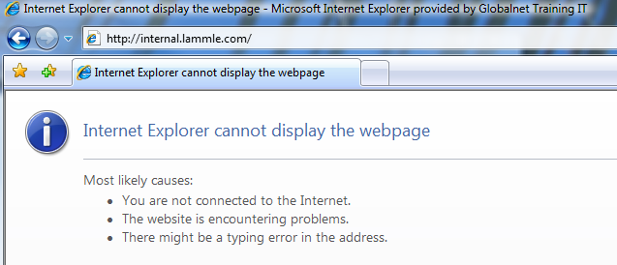
Troubleshooting Steps
Step 1: Identify the Problem
Question Users
Determine If Anything Has Changed
Identify Symptoms

Slide 8
Troubleshooting Steps
Step 2: Establish a Theory of Probable Cause
Question the Obvious
Port speed
Port duplex mismatch
Mismatched MTU
Incorrect VLAN
Incorrect IP address
Wrong gateway
Wrong DNS
Wrong subnet mask

Slide 9
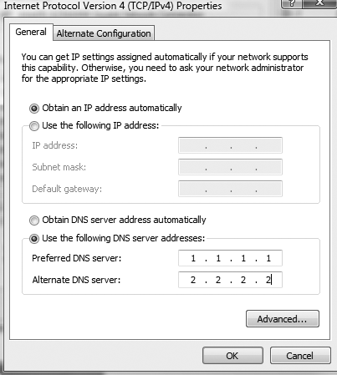
Troubleshooting Steps
Step 3: Test the Theory to Determine Cause

Slide 10
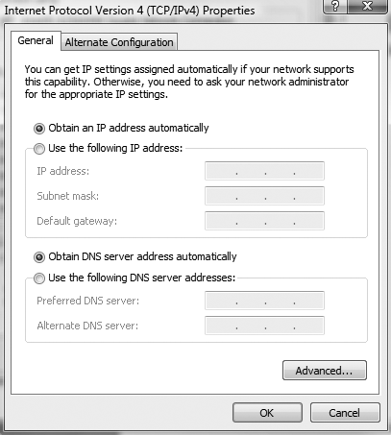
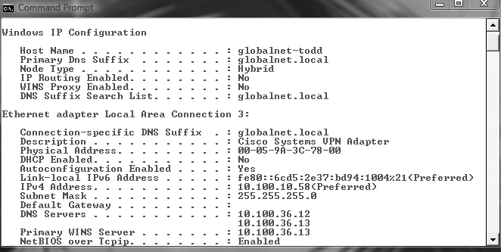
Troubleshooting Steps
Step 4: Establish a Plan of Action to Resolve
the Problem and Identify Potential Effects

Slide 11
Troubleshooting Steps
Step 5: Implement the Solution or Escalate as Necessary
Some of the calamities that you should escalate are as follows:
Switching loops
Missing routes
Routing loops
Routing problems
MTU black hole
Bad modules
Proxy Address Resolution Protocol (ARP)
Broadcast storms

Slide 12
Troubleshooting Steps
Step 6: Verify Full System Functionality and If
Applicable Implement Preventative Measures
Step 7: Document Findings, Actions, and Outcomes
A description of the conditions surrounding the problem
The OS version, the software version, the type of computer, and the type of NIC
Whether you were able to reproduce the problem
The solutions you tried
The ultimate solution

Slide 13
Troubleshooting Tips
Don’t Overlook the Small Stuff
Prioritize Your Problems
Check the Software Configuration
Don’t Overlook Physical Conditions
Don’t Overlook Cable Problems
Check for Viruses

Slide 14
Troubleshooting Steps Review
1. Identify the problem.
2. Establish a theory of probable cause.
3. Test the theory to determine cause.
4. Establish a plan of action to resolve the problem and identify potential effects.
5. Implement the solution or escalate as necessary.
6. Verify full system functionality and if applicable implement preventative measures.
7. Document findings, actions, and outcomes.

